Slide 1
Drowsiness Detection With Jetson Nano

Slide 2
Overview
Problem:
Drowsiness while driving is a leading cause of road accidents.
Drivers often do not realize when they are becoming drowsy due to:
Gradual onset of fatigue
Overestimation of their driving abilities
Microsleep
Routine and familiarity with the road
Reduced cognitive awareness due to fatigue
There is a need for an automated, real-time solution to monitor driver alertness and prevent accidents.
Solution:
The automatic drowsy detection system will help solve the above problems

Slide 3

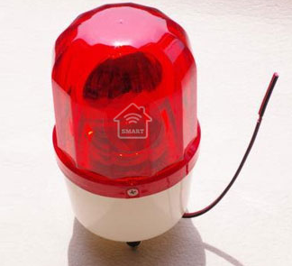
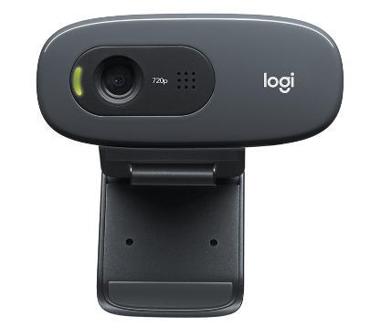
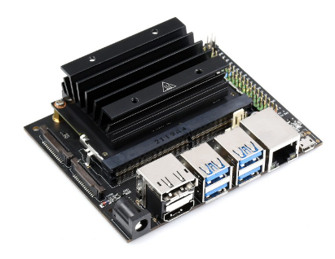
Diagram
Alarm
Driver
Camera
Jetson nano

Slide 4
AI Model
SSD-Mobilenet is used to re-train following this guideline: https://github.com/dusty-nv/jetson-inference
Dataset:
2 classes (awake, drowsy) consist of 300 images.
Images are collected from Roboflow.
Label, Annotate and export to VOC format by using Roboflow tool

Slide 5
Demo
Prerequisites:
Setup the Jetson nano 4GB and camera(Follow the guideline https://github.com/dusty-nv/jetson-inference).
Use 1 red LED to connect to GPIO pin 11. This LED simulates lid open/close control. When the LED lights it means the system detects drowsiness.
The model is retrained and exported to Onnx.

Slide 6
Demo
Steps:
Build project: following this guideline https://github.com/dusty-nv/jetson-inference/blob/master/docs/building-repo.md
Navigate to ssd folder: “jetson-inference/python/training/dectection/ssd”.
Open terminal, run “python train_ssd.py --dataset-type=voc”. Model file is in “jetson-inference/python/training/detection/ssd/model”.
Export onnx: python onnx_export.py --model-dir=models --labels=models/labels.txt
Run “python ssd_inference.py /dev/video0”.

Slide 7
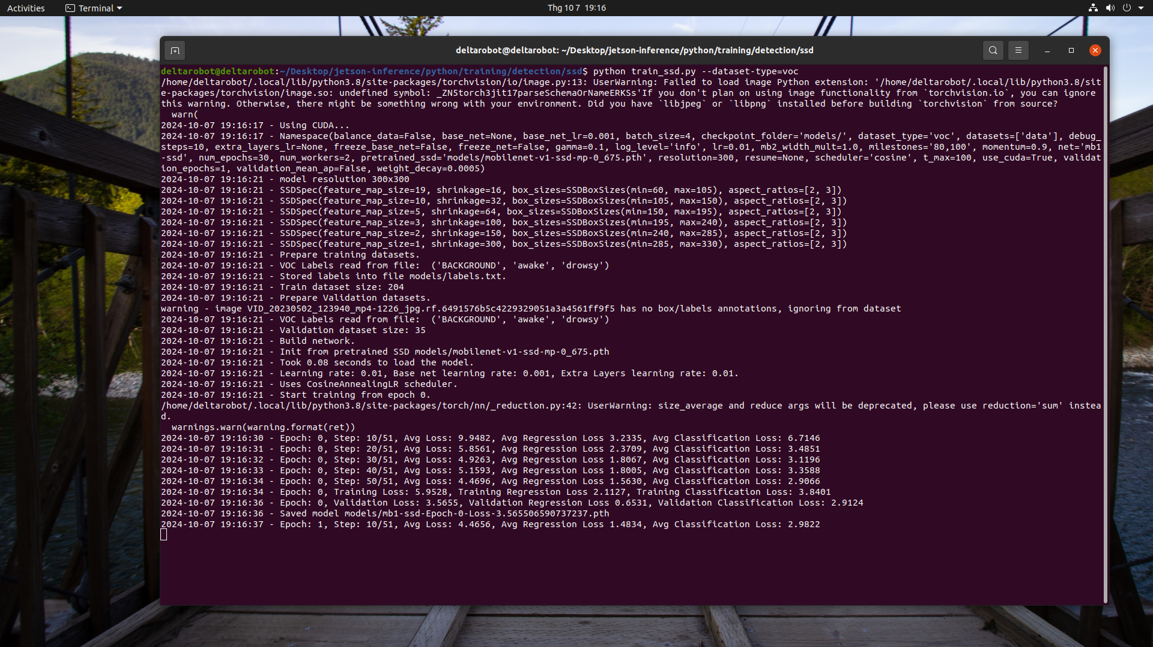
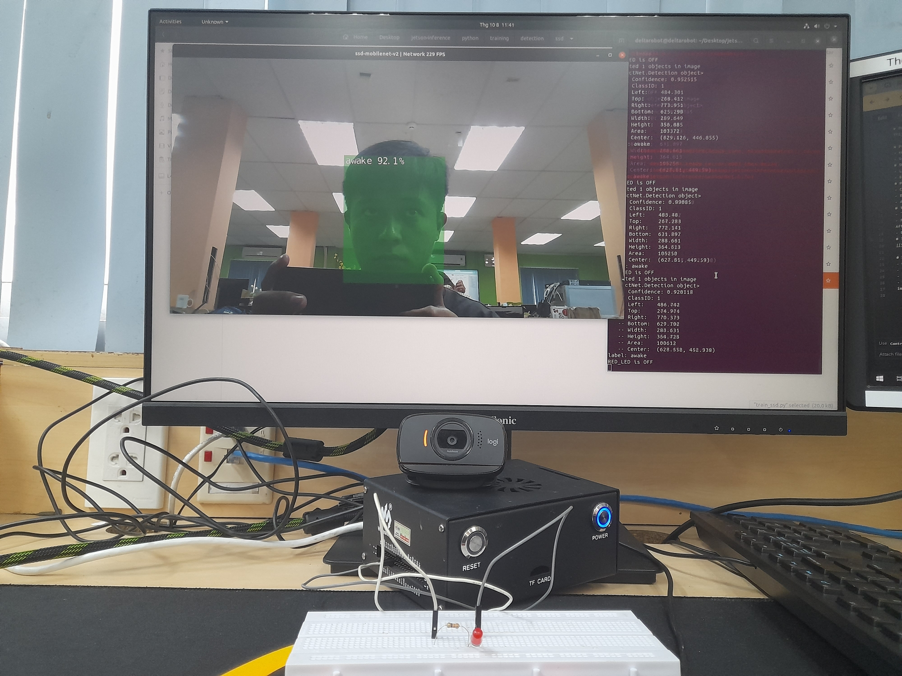
Images
Traning process
Demo

Slide 8
Thank you for your watching

